Slide 1
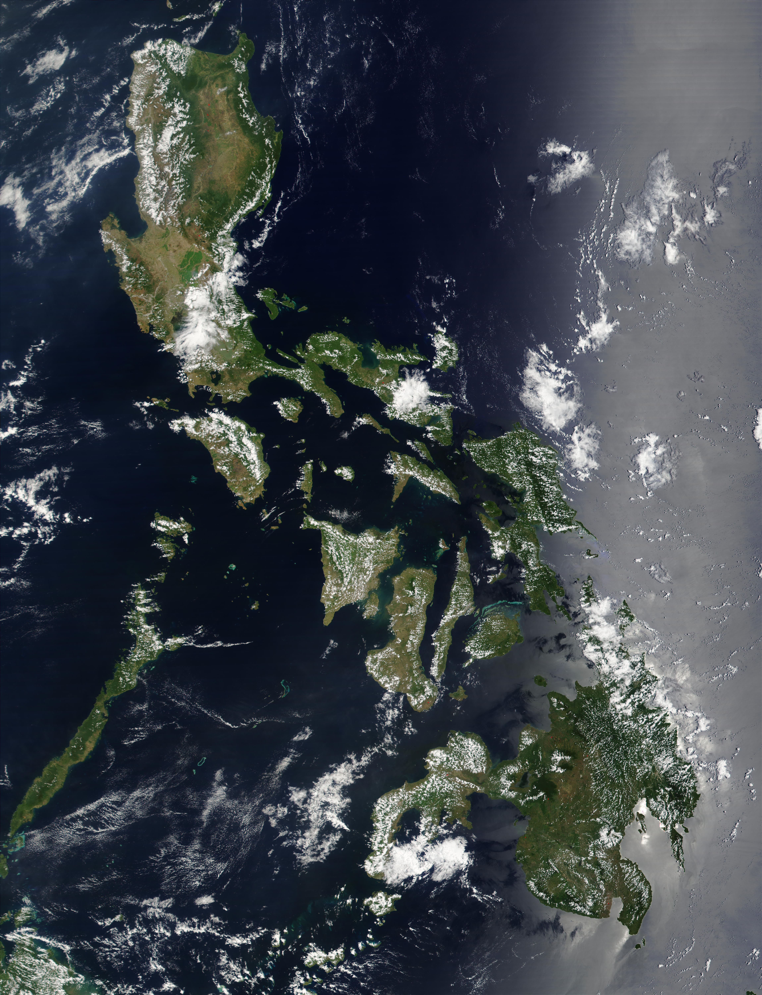
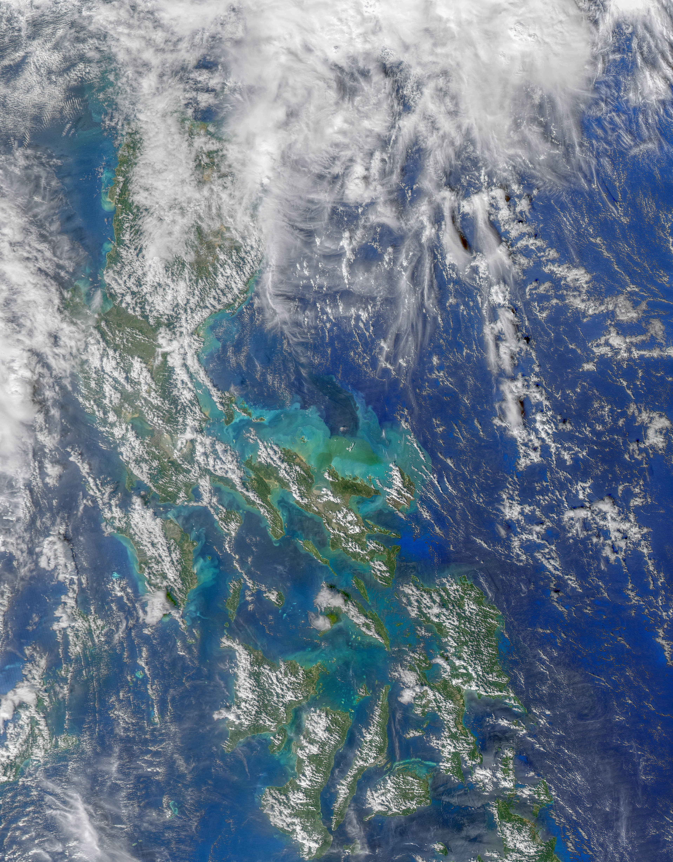
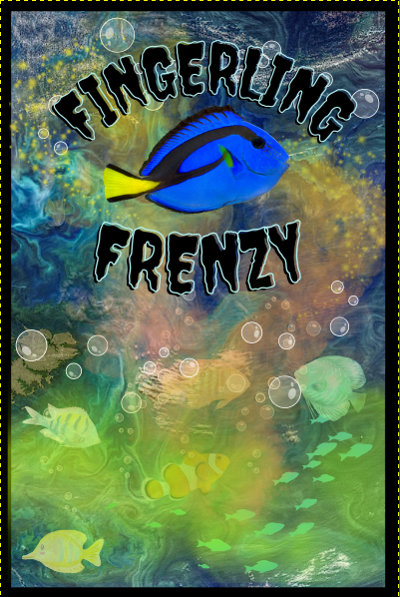
Fingerling Frenzy
A Coral Triangle Card Game
"Fingerling Frenzy" is an immersive educational game that transports players into the biodiverse but threatened ecosystem of the Coral Triangle.
This two-player game consists of a deck of cards of specific fish along with a computer-based scoring system.
In each round, the number of fish a player has is determined by the location on a map and fish characteristics including tolerance to pollution, size, and eating habits.
The first player to have a school of 100 fish wins.

Slide 2
Special Thanks
https://oceancolor.gsfc.nasa.gov/gallery/feature/images/A2020318045000.Philippines.jpg
https://oceancolor.gsfc.nasa.gov/gallery/
https://commons.wikimedia.org/wiki/File:Satellite_image_of_Philippines_in_March_2002.jpg
https://www.eurekalert.org/multimedia/588757

Slide 3
Motivation
Coral reefs contain over 800 different species and a quarter of all ocean animals.
From 2009-2018, 14% of coral reef habitats were lost.
We wanted to learn and share information about these threatened coral reef habitats and the biodiversity of fish that they support.
https://oceancolor.gsfc.nasa.gov/gallery/feature/images/A2020318045000.Philippines.jpg

Slide 4
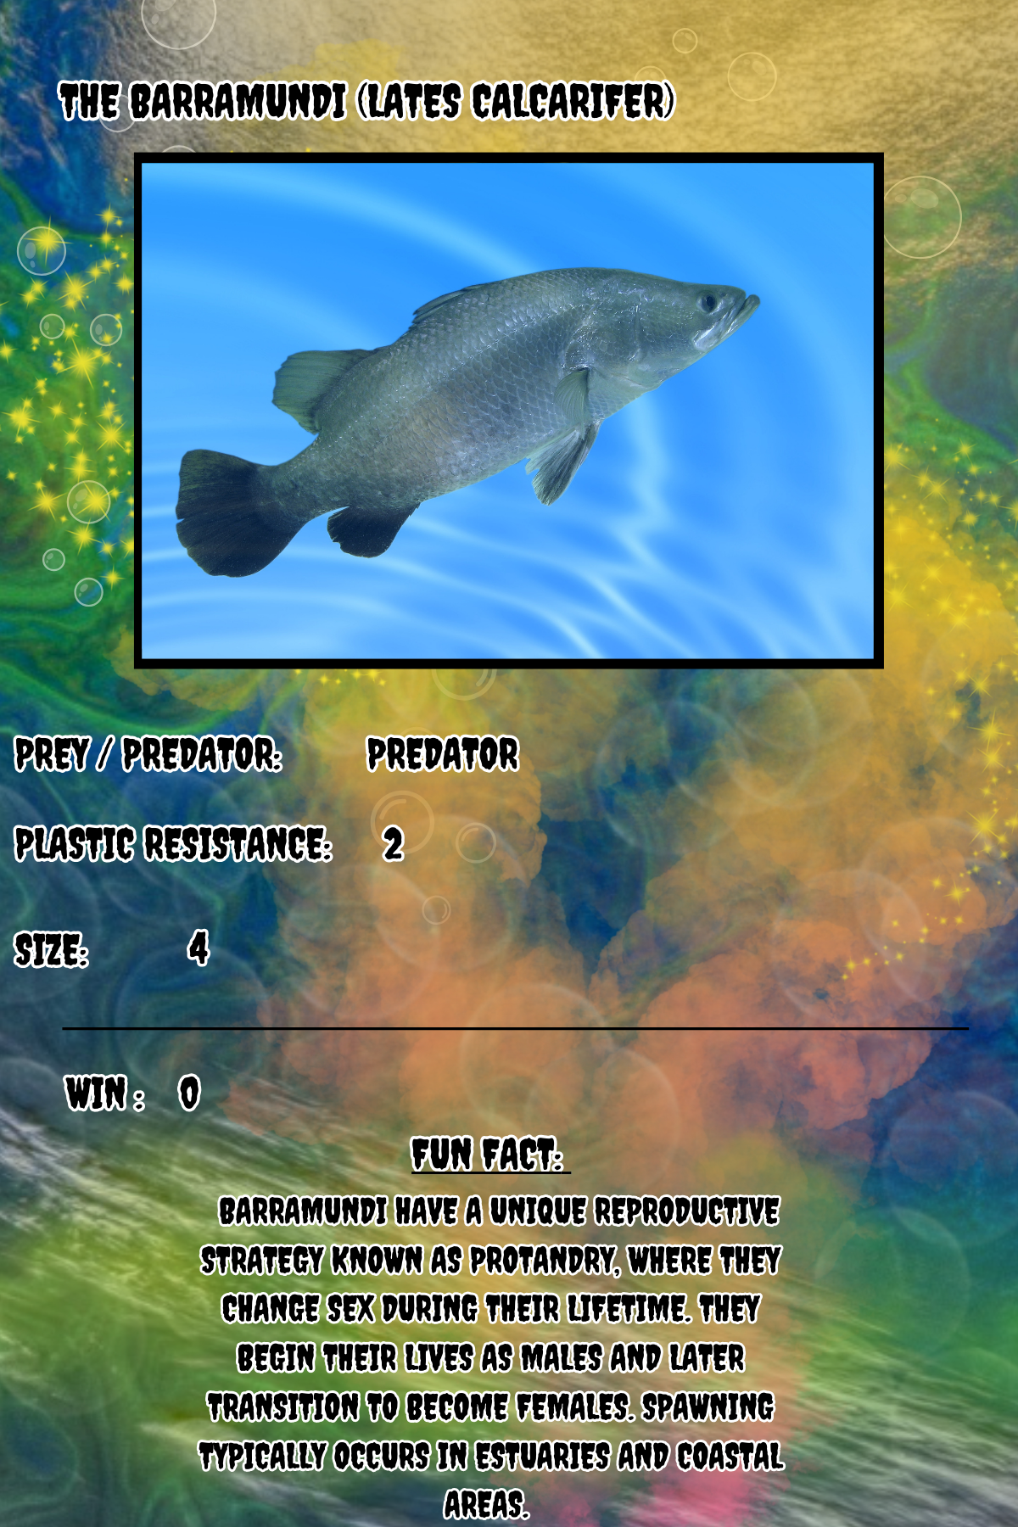
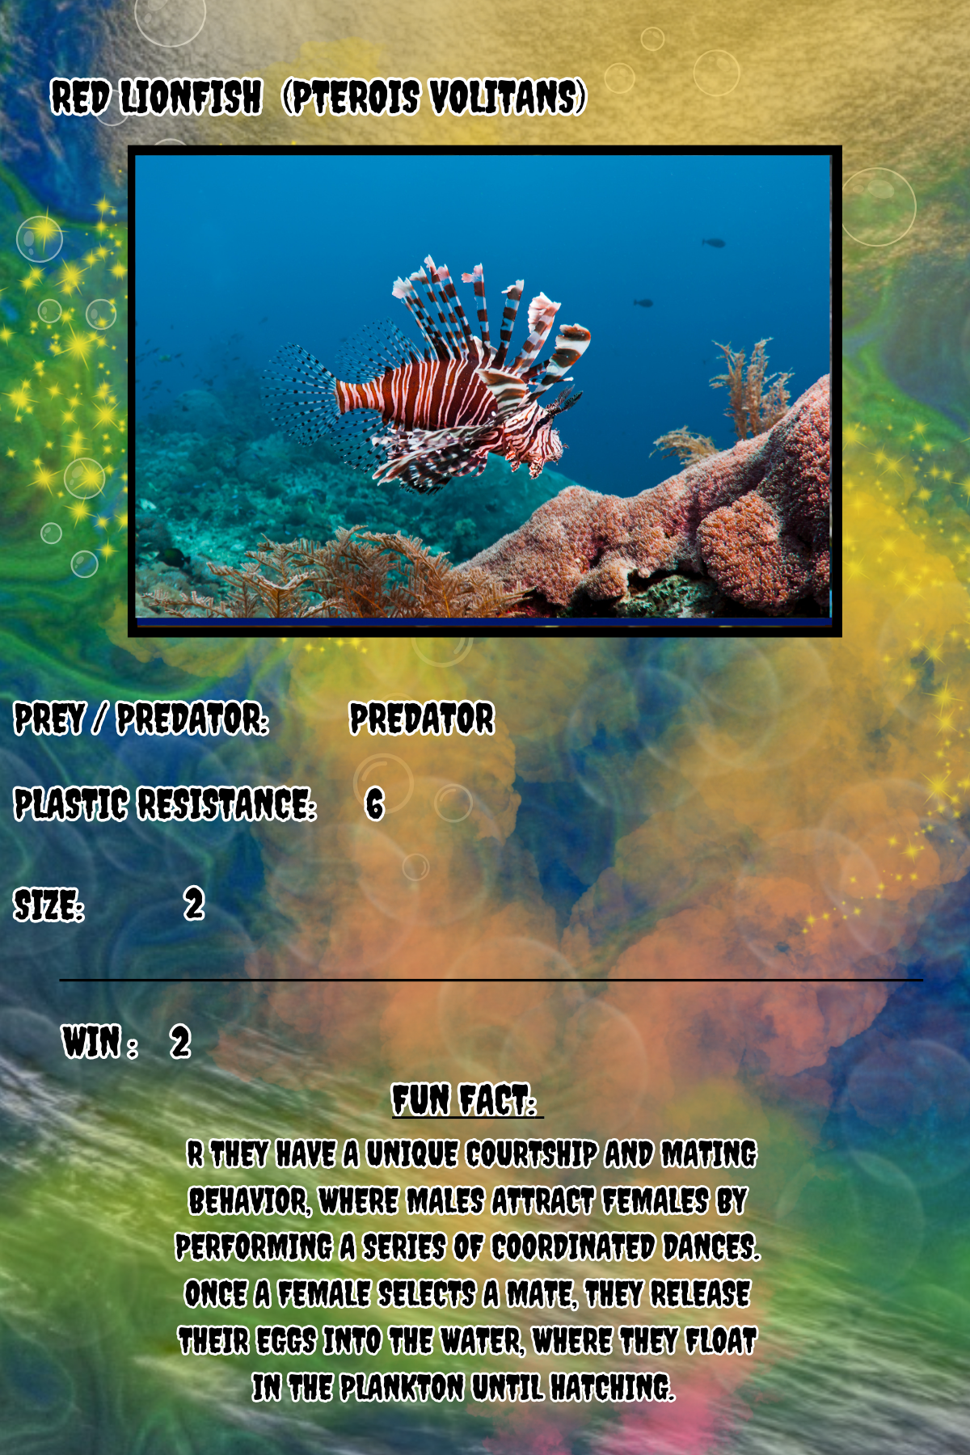
Game play
Shuffle the cards.​
Deal each player 5 cards face down.​
Each player should look at their cards but not show them to their opponent.​
Players say aloud
“One, Two, Baby Fish”.
On the words
“Baby Fish”,
players simultaneously lay down a card.
Now time for the computer side...
NASA Ocean Color Home - Canva
Notes:
Game setup:
Clone our github repository to your local machine.
Open the game calculator, game.html, in a web browser.
Print out three copies of the card deck.
Round setup:
Shuffle the cards.
Deal each player 5 cards face down.
Each player should look at their cards but not show them to their opponent.

Slide 5
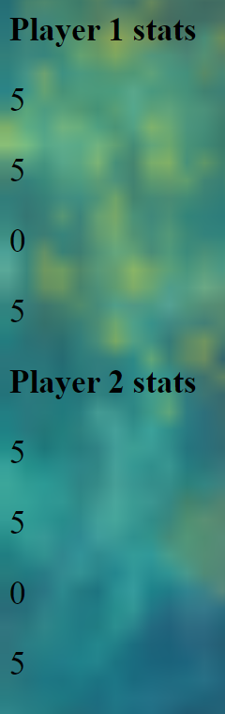
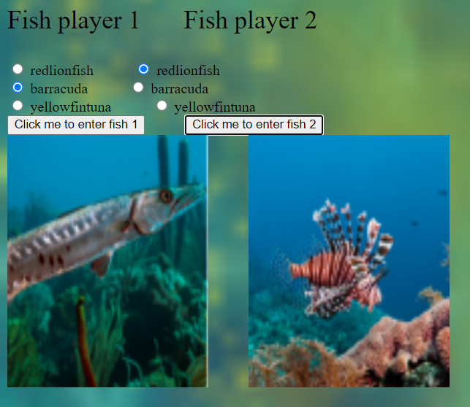
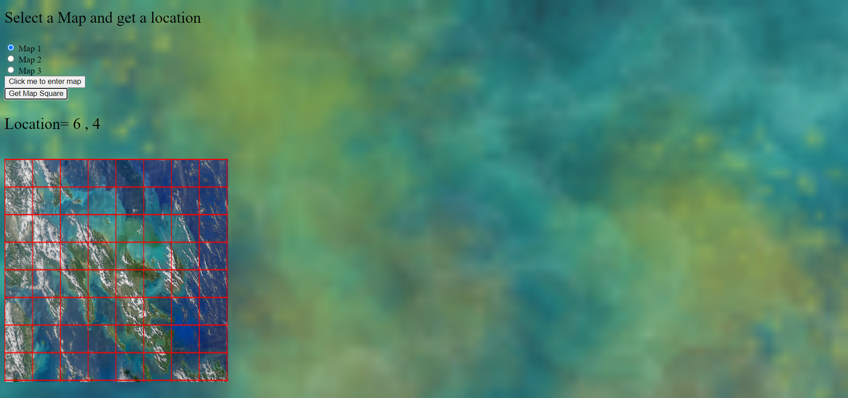
Game Play
On the computer, Select a map, and press the button to choose a random location.
Each player enters the fish they played into the calculator.
The calculator updates each player’s fish school size.
(Note: both players must enter their fish before fish school size is be updated.)
Additional rounds are played until someone collects a fingerling size of 100.

Slide 6
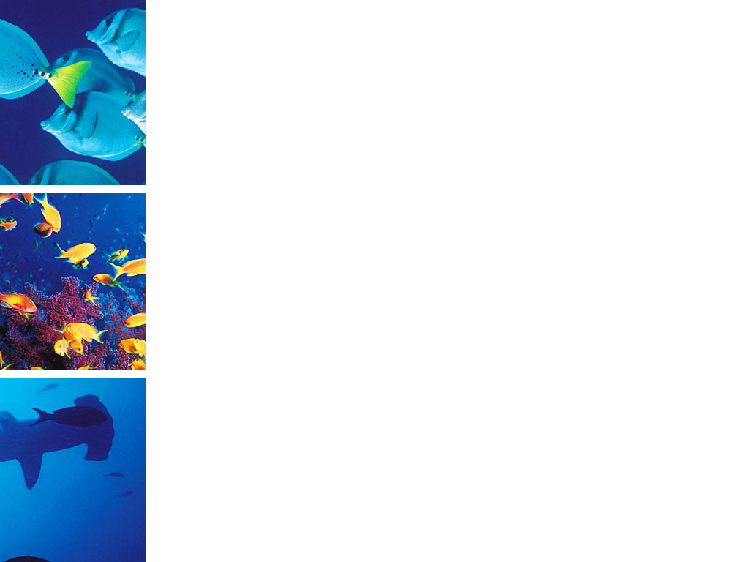
References
https://www.fisheries.noaa.gov/species/oceanic-whitetip-shark#:~:text=The%20reproductive%20cycle%20is%20thought,pups%20(average%20of%206).
https://www.virginiaaquarium.com/things-to-do/great-barracuda
https://en.wikipedia.org/wiki/Giant_grouper
https://snorkelingthailand.com/moray-eel-facts/
https://myfwc.com/wildlifehabitats/profiles/saltwater/lionfish/#:~:text=Males%20mature%20at%20about%204,12%2C000%20to%2015%2C000%20eggs%20each.
https://oceana.org/marine-life/yellowfin-tuna/#:~:text=3.%20Female%20yellowfin%20tuna%20species,4%20million%20eggs%20when%20spawning.&text=4.,maximum%20lifespan%20of%207%20years.
https://greatsouthernreef.com/blueringed-octopus#:~:text=During%20the%20mating%20season%20the,shortly%20after%20the%20eggs%20hatch.
https://adapt136.ucsc.edu/taxa/invertebrates/the-common-octopus-is-facing-even-more-common-problems-and-it-s-our-fault#:~:text=It%20was%20shown%20in%20a,many%20other%20common%20ocean%20ollutants.
https://www.britannica.com/animal/sea-snake
Hydrophis schistosus (Beaked sea snake) | Taxonomy | UniProt
https://www.longdom.org/open-access/threat-to-sea-snakes-from-bycatch-through-imperilled-fishing-nets-utilization-report-on-rescue-of-sea-snakes-from-by-catch-at-kund-96846.html#:~:text=Bycatch%20of%20sea%20snakes%20due,required%20for%20effective%20problem%20management.
https://oceana.org/marine-life/saltwater-crocodile/#:~:text=Though%20they%20spend%20much%20of,clutch%20of%20approximately%2050%20eggs.
Giant Trevally l Amazing Bird-Eating Fish - Our Breathing Planet
https://news.mongabay.com/2017/11/plastic-in-the-ocean-smells-like-junk-food-to-hungry-anchovies/#:~:text=The%20odors%20of%20plastic%20pieces,rely%20on%20them%20for%20food.
Indian oil sardine - Alchetron, The Free Social Encyclopedia
https://www.sciencedirect.com/science/article/abs/pii/S0269749121010319
https://www.frontiersin.org/articles/10.3389/fenvs.2021.641135/full
https://bioplasticsnews.com/2019/08/28/israel-tests-3d-printed-coral-reefs-made-from-pla/
https://hakaimagazine.com/news/we-have-unrealistic-beauty-standards-for-coral-too/
https://bioplasticsnews.com/2019/08/28/israel-tests-3d-printed-coral-reefs-made-from-pla/
https://www.americanoceans.org/facts/what-are-pelagic-fish/
https://www.nationalgeographic.com/magazine/article/philippines-reefs-are-some-of-the-most-vibrant-but-in-peril-feature
https://www.worldwildlife.org/places/coral-triangle
https://coraltriangleadventures.com/ambush-predators-of-komodo-is/
Statistics on coral reefs: https://www.unep.org/interactives/status-world-coral-reefs/
Ivani sounds
Sound effects in Javascript: https://www.w3schools.com/jsref/tryit.asp?filename=tryjsref_audio_play
https://oceancolor.gsfc.nasa.gov/gallery/feature/images/A2020318045000.Philippines.jpg

Slide 7
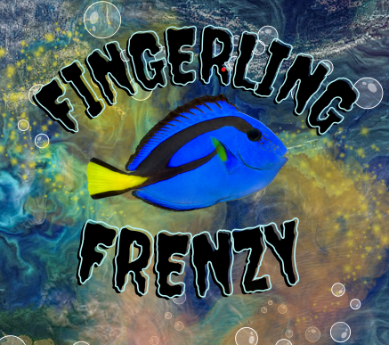
QUESTIONS ?
Brought to you by: TRINE UNIVERSITY

